Slide 1
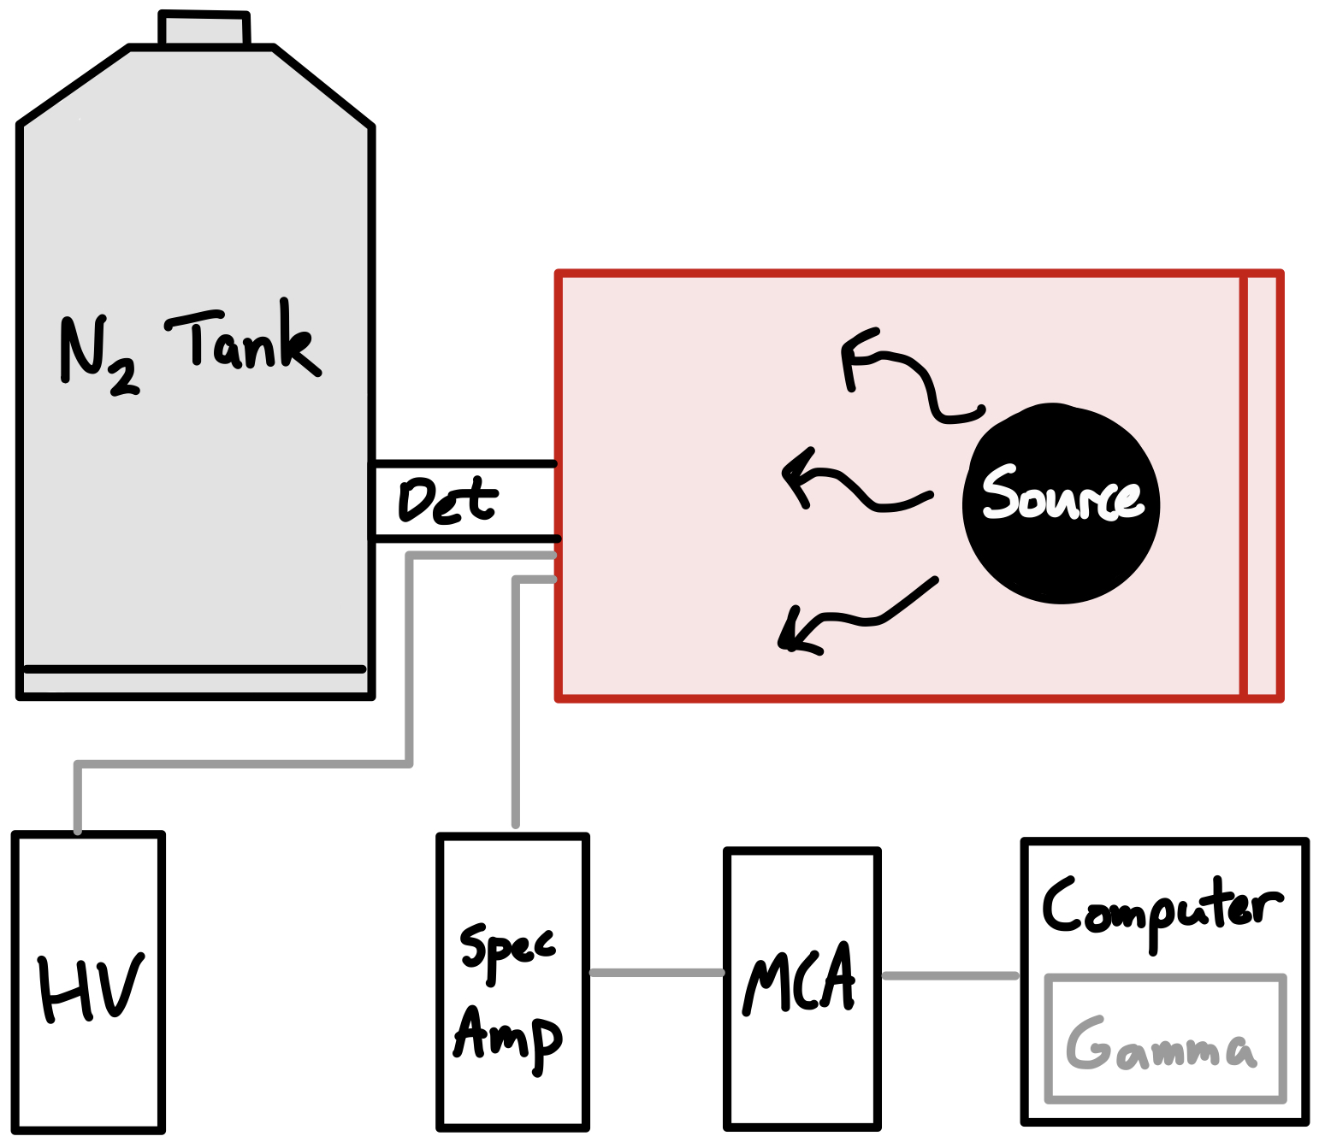

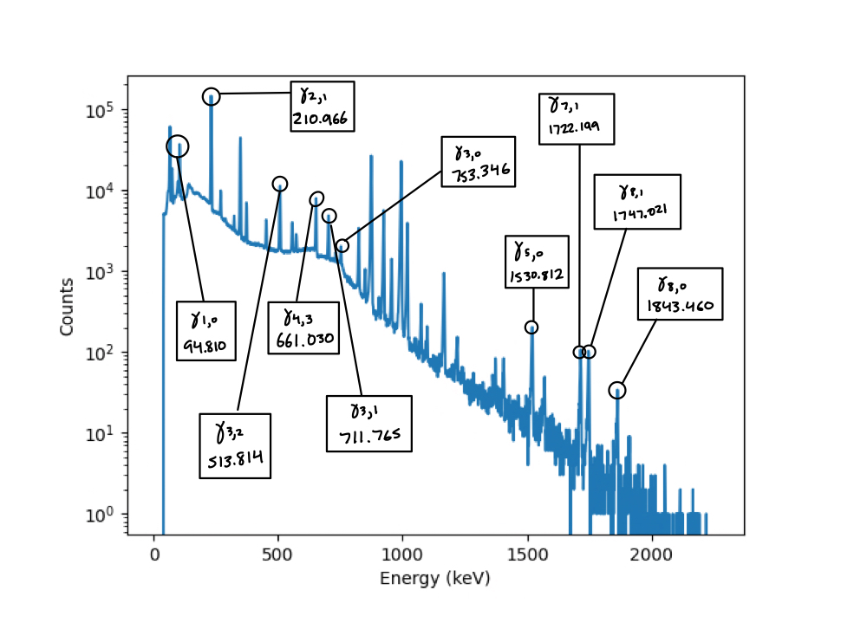

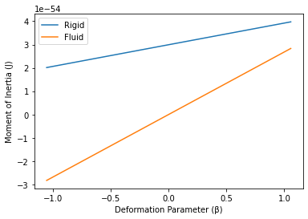
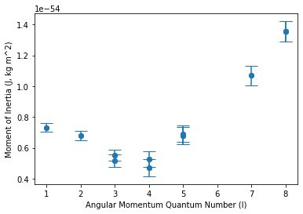
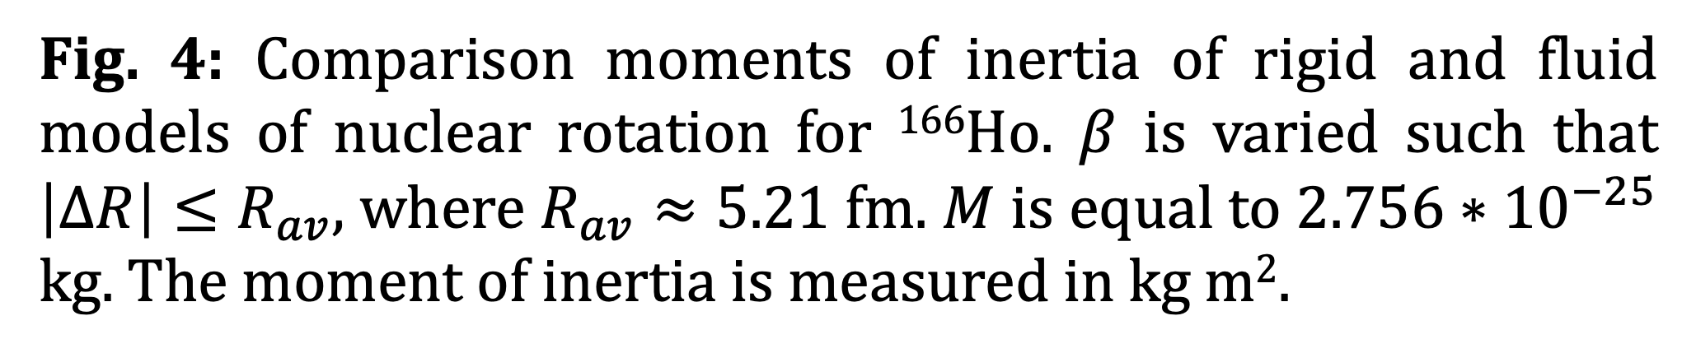
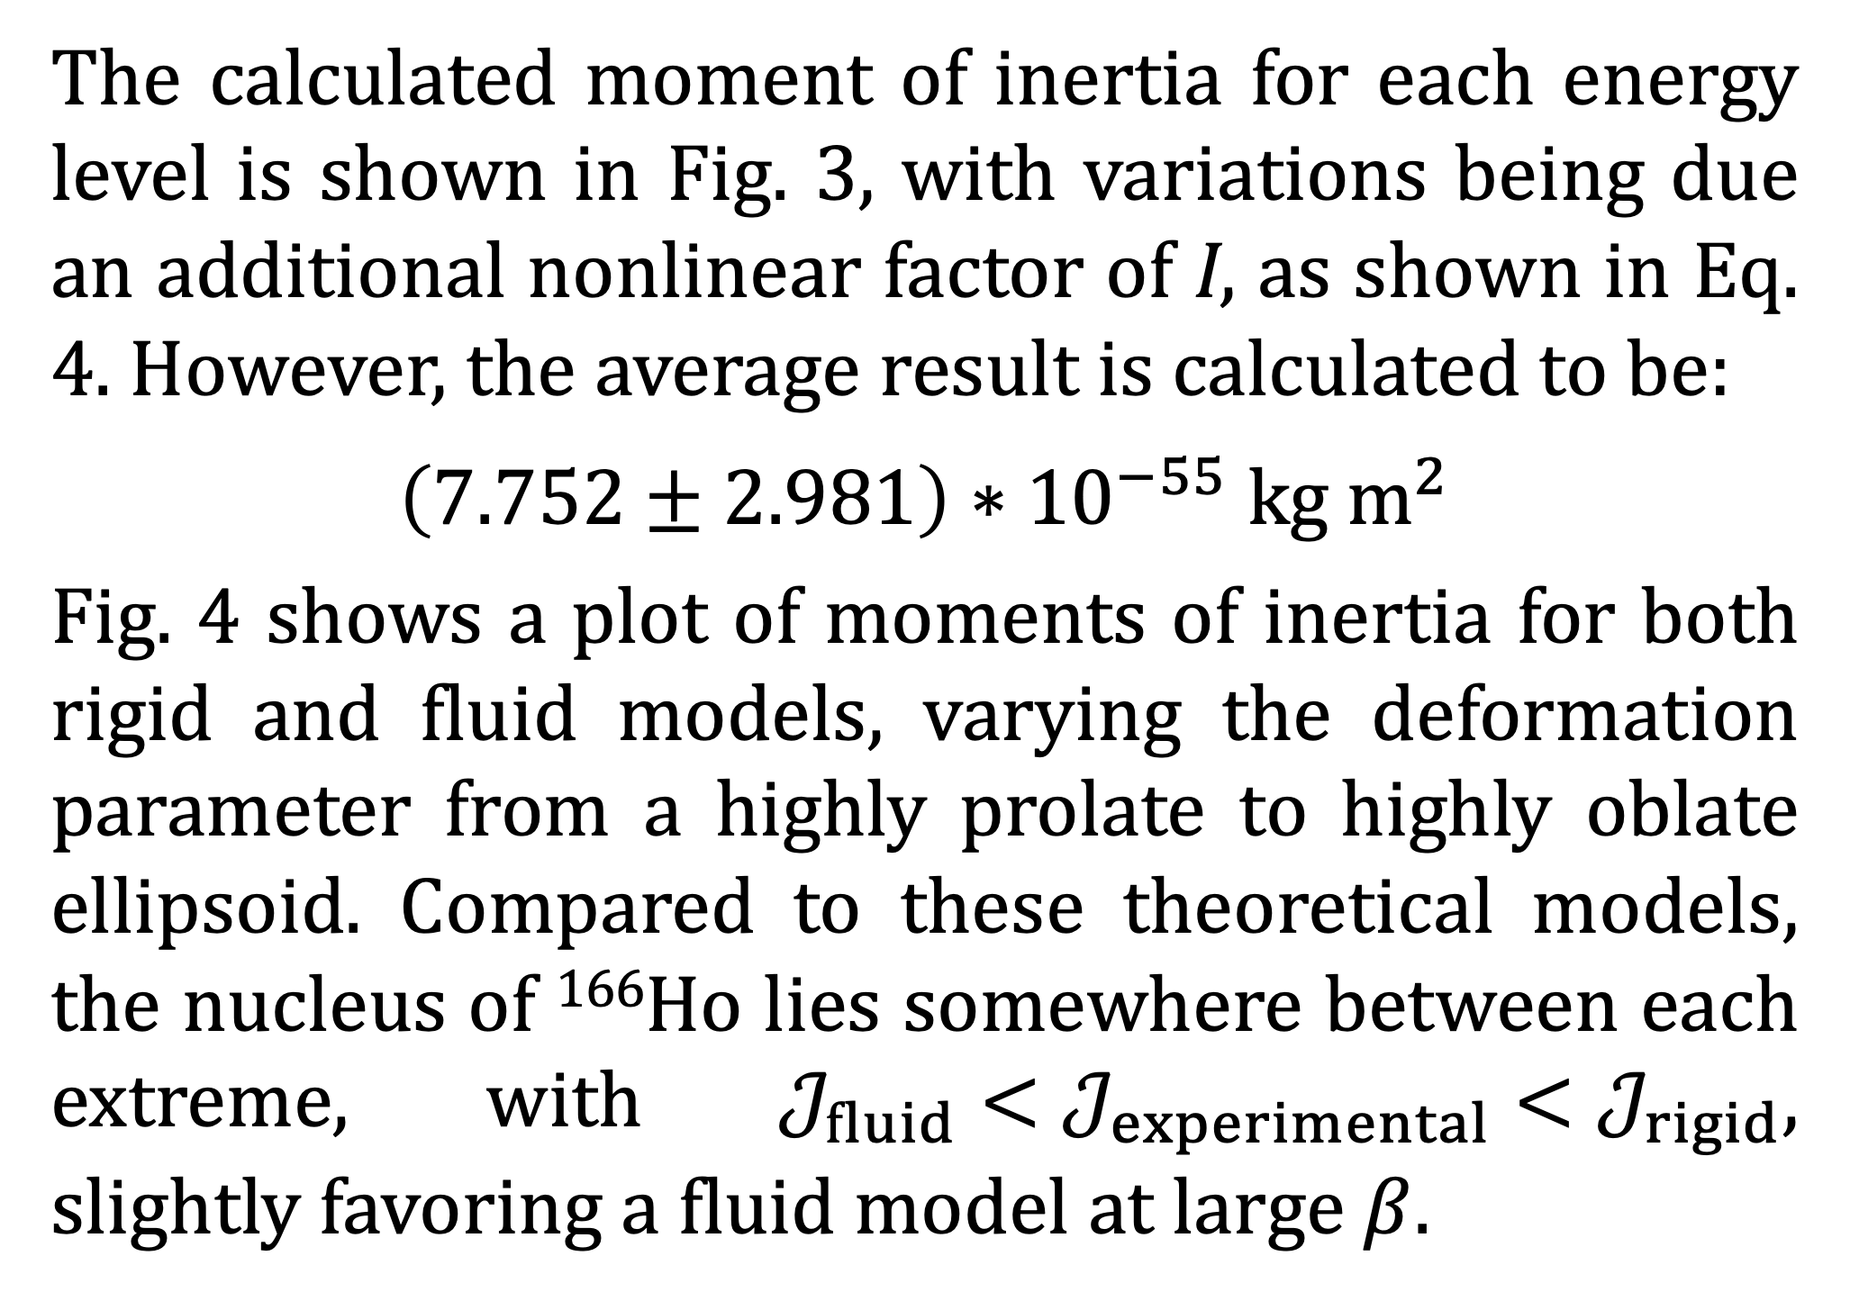
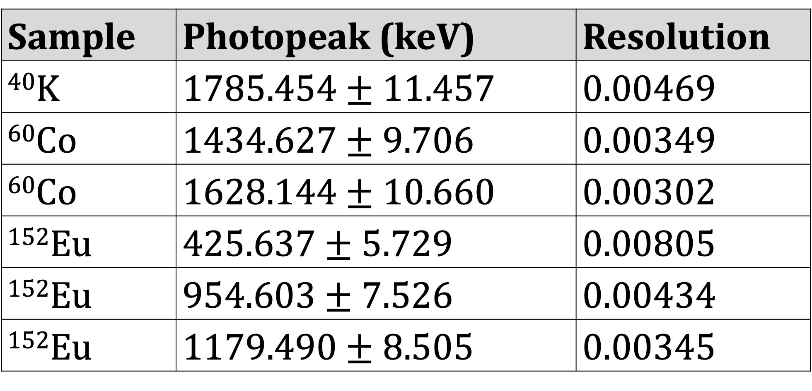
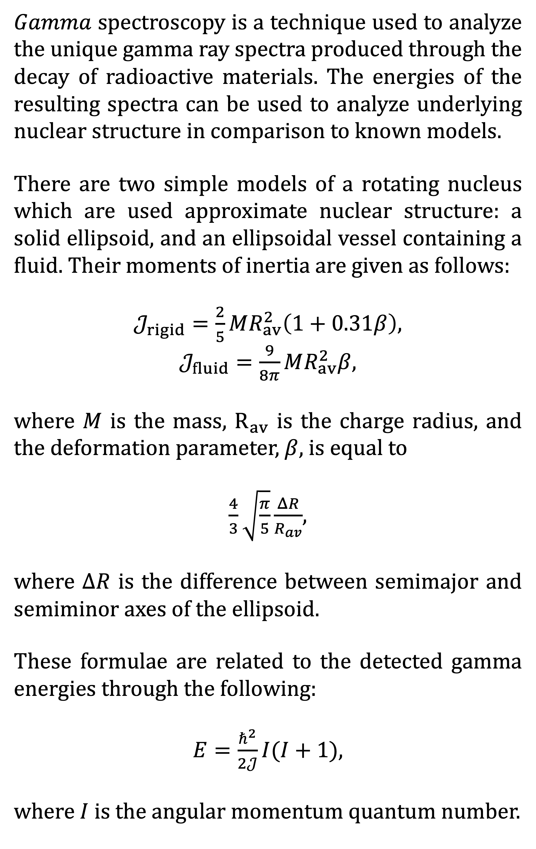
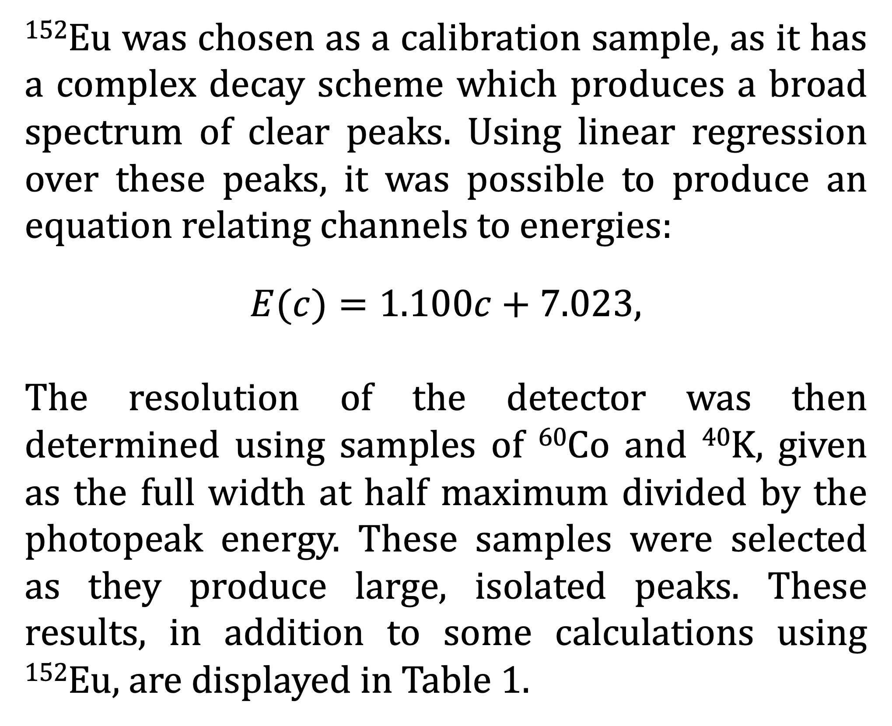
Comparison of Nuclear Models of Rotation Using Gamma Spectroscopy on ¹⁶⁶Ho
Background
¹⁶⁶Ho Results
Contact Information
$Gamma$ spectroscopy is a technique used to analyze the unique gamma ray spectra produced through the decay of radioactive materials. The energies of the resulting spectra can be used to analyze underlying nuclear structure in comparison to known models.
There are two simple models of a rotating nucleus which are used approximate nuclear structure: a solid ellipsoid, and an ellipsoidal vessel containing a fluid. Their moments of inertia are given as follows:
$𝒥_{rigid}=\frac{2}{5}MR_{av}^{2}\left(1+0.31β\right)$,
$𝒥_{fluid}=\frac{9}{8π}MR_{av}^{2}β$,
where $M$ is the mass, $R_{av}$ is the charge radius, and the deformation parameter, $β$, is equal to
$\frac{4}{3}\sqrt{\frac{π}{5}}\frac{ΔR}{R_{av}}$,
where $ΔR$ is the difference between semimajor and semiminor axes of the ellipsoid.
These formulae are related to the detected gamma energies through the following:
$E=\frac{ℏ^{2}}{2𝒥}I(I+1)$,
where $I$ is the angular momentum quantum number.
¹⁶⁶Ho was analyzed using the calibration and resolution data from the previous samples. Spectroscopy data is shown in Fig. 2, with some of the major peaks labelled.
Isaiah Mumaw
imumaw@nd.edu
(1)
(2)
Fig. 1: Block diagram of experimental setup
Calibration, Resolution
¹⁵²Eu was chosen as a calibration sample, as it has a complex decay scheme which produces a broad spectrum of clear peaks. Using linear regression over these peaks, it was possible to produce an equation relating channels to energies:
$E(c)=1.100c+7.023$,
The resolution of the detector was then determined using samples of ⁶⁰Co and ⁴⁰K, given as the full width at half maximum divided by the photopeak energy. These samples were selected as they produce large, isolated peaks. These results, in addition to some calculations using ¹⁵²Eu, are displayed in Table 1.
Fig. 2: Data for ¹⁶⁶Ho, with some of the major peaks labelled with their associated energies and decay states.
(3)
(5)
Fig. 4: Comparison moments of inertia of rigid and fluid models of nuclear rotation for ¹⁶⁶Ho. $β$ is varied such that $\left|ΔR\right|≤R_{av}$, where $R_{av}≈5.21$ fm. $M$ is equal to $2.756∗{10}^{−25}$ kg. The moment of inertia is measured in kg m².
(4)
Fig. 3: Calculated moments of inertia for measured energy peaks.
Discussion
Experimental Setup
The calculated moment of inertia for each energy level is shown in Fig. 3, with variations being due an additional nonlinear factor of I, as shown in Eq. 4. However, the average result is calculated to be:
$$\left(7.752±2.981\right)∗{10}^{−55} kg m^{2}$$
Fig. 4 shows a plot of moments of inertia for both rigid and fluid models, varying the deformation parameter from a highly prolate to highly oblate ellipsoid. Compared to these theoretical models, the nucleus of ¹⁶⁶Ho lies somewhere between each extreme, with $𝒥_{fluid}<𝒥_{experimental}<𝒥_{rigid},$ slightly favoring a fluid model at large $β$.
The results here deviated from both the fluid and rigid models of nuclear rotation, which was within expectations, as nuclei contain multiple particles bound by the strong force, and structure can vary depending on the energy state of the nucleus due to a partially quadratic relationship between energy and angular momentum.
There is some inherent uncertainty in gamma spectroscopy due to the reliance on visual inspection, resulting in some methodological error. However, through proper analysis it was still possible to produce reasonable results.
Samples of ¹⁵²Eu, ⁶⁰Co, ⁴⁰K, and ¹⁶⁶Ho were placed inside of a lead-shielded chamber. Emitted photons travelled into a germanium-type detector (Det), powered by a high voltage power source (HV) and cooled using a tank of liquid N₂.
Signals from the detector travelled to a spectroscopy amplifier (Spec Amp), designed to amplify and shape data. A multichannel analyzer (MCA) divided the signal into bins, which were read and visualized by the computer. This setup can be viewed in Fig. 1.
Table 1: Resolution calculations for ⁶⁰Co and ⁴⁰K, in addition to some select calculations from ¹⁵²Eu.
Sample | Photopeak (keV) | Resolution
⁴⁰K | $$1785.454±11.457$$ | 0.00469
⁶⁰Co | $$1434.627±9.706$$ | 0.00349
⁶⁰Co | $$1628.144±10.660$$ | 0.00302
¹⁵²Eu | $$425.637±5.729$$ | 0.00805
¹⁵²Eu | $$954.603±7.526$$ | 0.00434
¹⁵²Eu | $$1179.490±8.505$$ | 0.00345
(6)

Slide 2
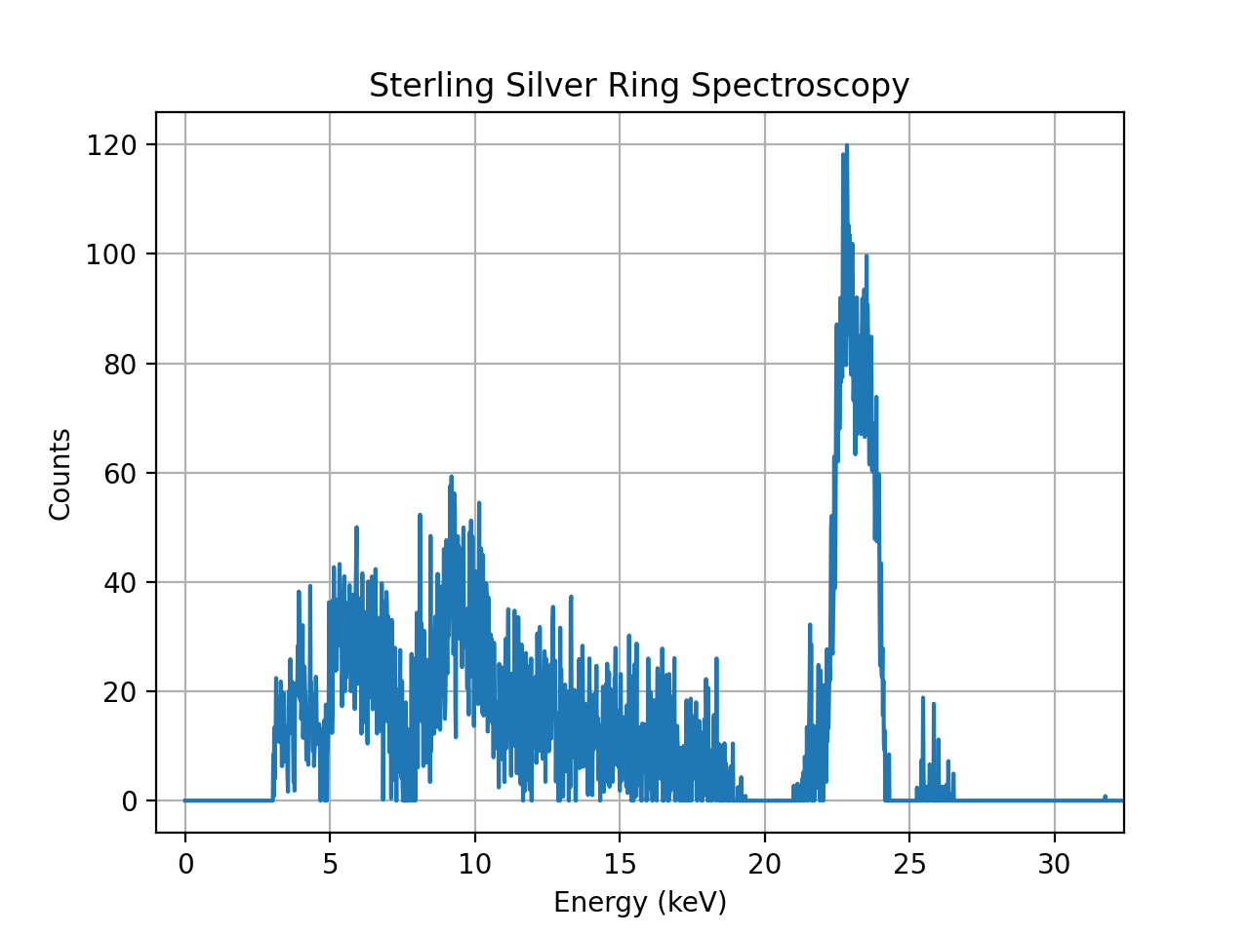
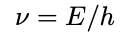
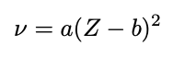
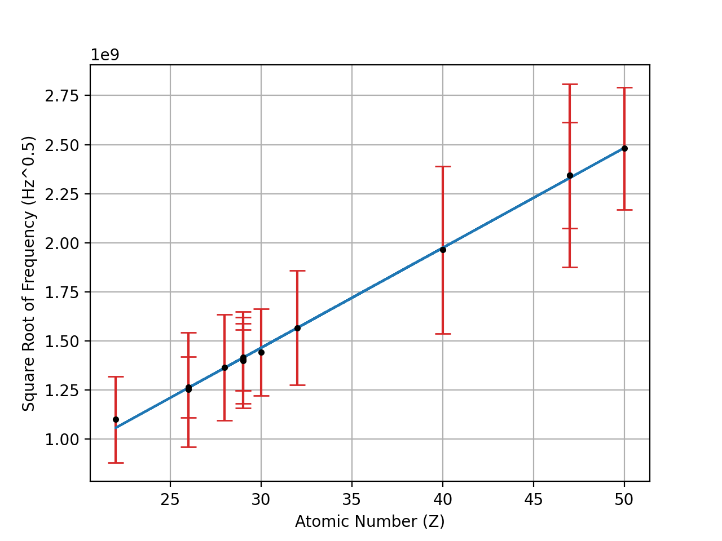
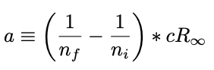
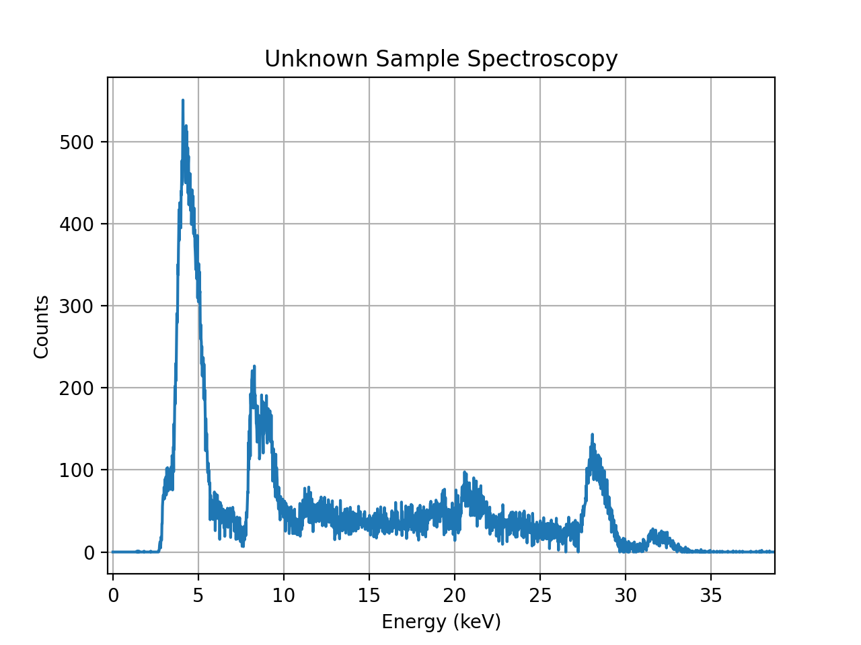
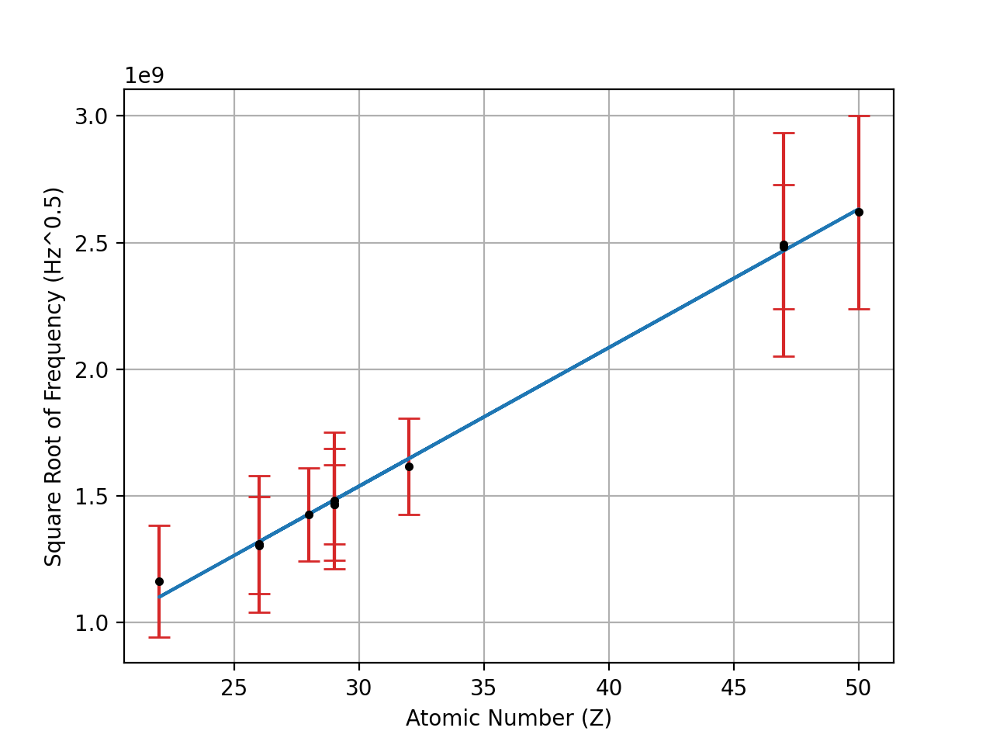
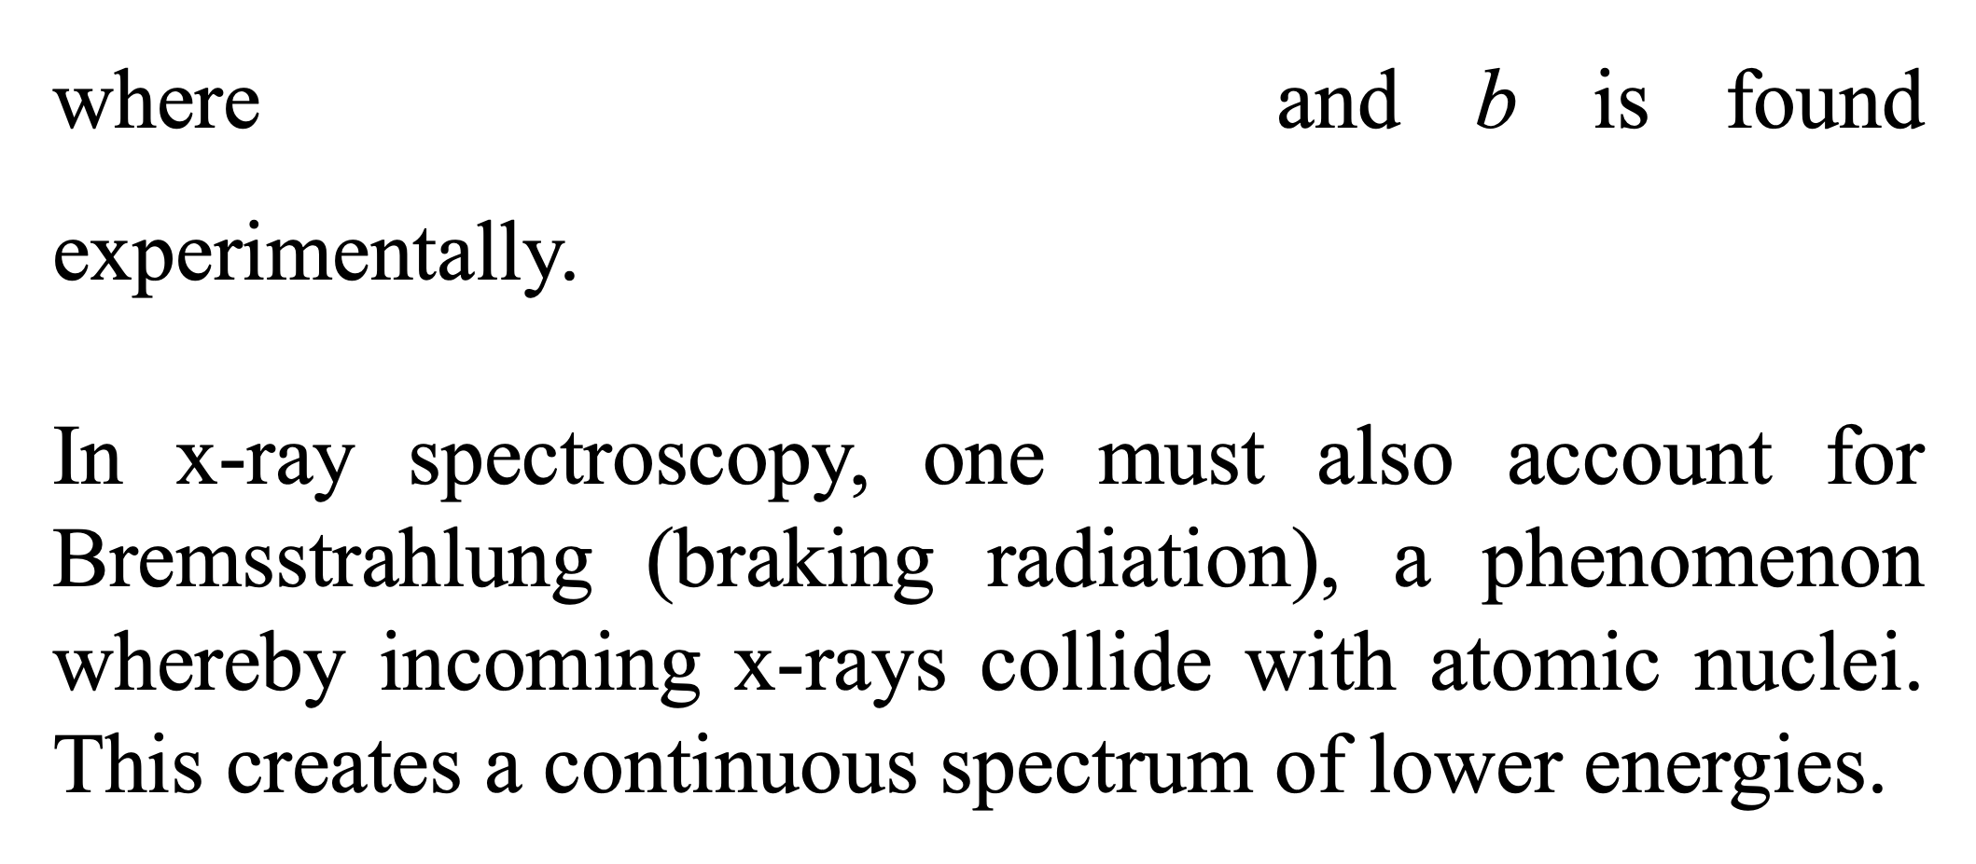
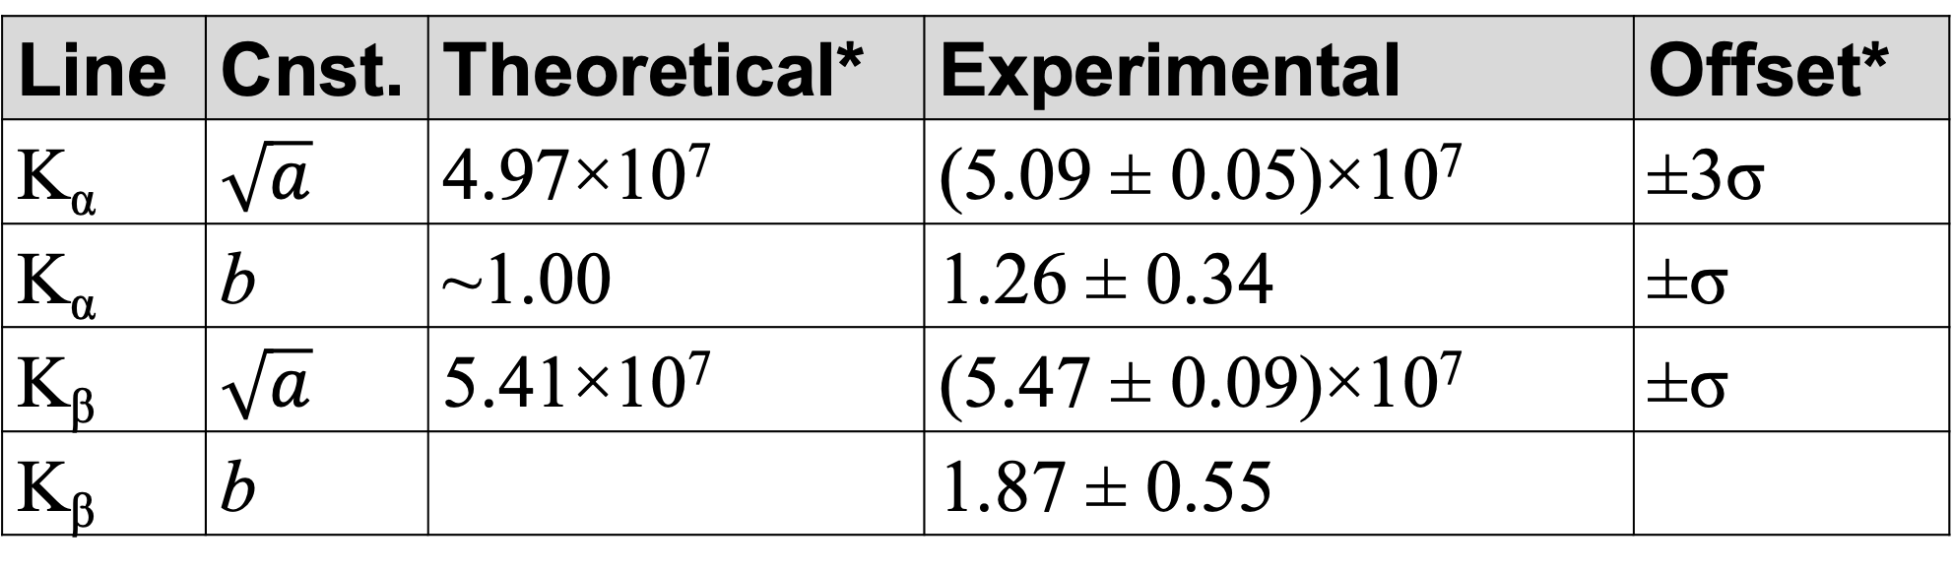
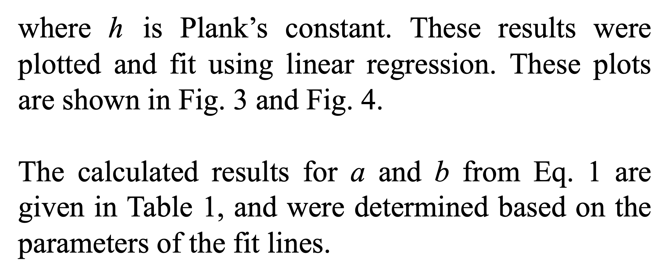
Verification and Application of Moseley’s Law through X-Ray Spectroscopy
Background
Spectroscopic Results
Verifying Moseley’s Law
Contact Information
X-ray spectroscopy is a process by which a beam of x-rays is fired at a sample of material. This causes the sample to fluoresce in the x-ray range with a spectrum unique to each element. Spectral lines are labelled using K, L, etc. for the final electron level, and α, β, etc. to describe size of the jump between levels.
These spectral lines are predicted using Moseley’s law, which gives a linear relationship between the square root of the frequency of emitted x-rays and the atomic number of the sample:
The experimentally determined energy for each K_{α} and K_{β} spectral line was converted to the frequency using the following:
Isaiah Mumaw
imumaw@nd.edu
Ag, K_{α}
22.7 ± 0.9 keV
Cu, K_{α}
8.1 ± 0.2 keV
Cu, K_{β}
9.1 ± 0.3 keV
Ag, K_{β}
25.7 ± 0.8 keV
where $\text{h}$ is Plank’s constant. These results were plotted and fit using linear regression. These plots are shown in Fig. 3 and Fig. 4.
The calculated results for a and b from Eq. 1 are given in Table 1, and were determined based on the parameters of the fit lines.
Bremsstrahlung Radiation
Unknown Samples
Several unknown samples were analyzed using our experimental results for Eq. 1. By plugging in the peak energies, we can determine the elemental composition. Fig. 5 shows an example of this.
where $a ≡\left(\frac{1}{n_{f}}−\frac{1}{n_{i}}\right)∗ cR_{∞}$ and b is found experimentally.
In x-ray spectroscopy, one must also account for Bremsstrahlung (braking radiation), a phenomenon whereby incoming x-rays collide with atomic nuclei. This creates a continuous spectrum of lower energies.
Fig. 2: Annotated spectroscopy results for a sterling silver ring. Background noise has been accounted for.
First, a series of samples of known composition were analyzed. Most samples had very clear K_{α} and K_{β} peaks due to the energy range of our detector.
The energies for each peak were determined manually, with the error range being given as the width of the peak. Fig 2. shows an annotated example.
To account for background noise, one run was performed without a sample in place, with the results being subtracted from the spectroscopy data.
Channels were scaled to energy by calibrating with radioactive materials of known energy output.
Sc, K_{α}
4.2 ± 0.2 keV
Cu, K_{α}
8.2 ± 0.1 keV
Te, K_{α}
28.1 ± 0.3 keV
Experimental Setup
Cu, K_{β}
9.0 ± 0.3 keV
Te, K_{β}
31.7 ± 0.7 keV
Fig. 3: Overall K_{α} results, plotted as atomic number vs. square root of frequency.
Fig. 5: Annotated spectroscopy results for an unknown sample. Background noise has been accounted for.
Discussion
Fig. 1: Block diagram of experimental setup
Table 1: Experimental results for Moseley’s law. Included square roots to match with linear plot. *Note that there is no well-established theoretical value for b with K_{β}.
The results here were well in line with the predictions of Moseley’s law. While the peaks did seem to come in at energies above the literature value (either due to imprecise calibration or through calibration drift), by recalculating the constants in Moseley’s law it was possible to account for this, thus reliably predicting the composition of unknown samples.
Samples were placed under an X-ray tube (XR) with its own power supply (PS). Fluoresced photons travelled into a nitrogen-cooled SiLi detector (DET), powered by a high-voltage supply (HV). A pre-amplifier, spectroscopy amplifier, and multichannel analyzer cleaned up the raw signal and converted it into a readable format to be read by the computer. This setup is pictured in Fig. 1.
Line | Cnst. | Theoretical* | Experimental | Offset*
K_{α} | $$\sqrt{a}$$ | 4.97$\text{×}$10⁷ | (5.09 ± 0.05)$\text{×}$10⁷ | ±3σ
K_{α} | b | ~1.00 | 1.26 ± 0.34 | ±σ
K_{β} | $$\sqrt{a}$$ | $$\text{5.41}\text{×}\text{10}\text{7}$$ | (5.47 ± 0.09)$\text{×}$10⁷ | ±σ
K_{β} | b |  | 1.87 ± 0.55
Fig. 4: Overall K_{β} results, plotted as atomic number vs. square root of frequency

